Slide 1
Detection and Prevention of Vehicle Insurance Claim Fraud Leveraging Machine Learning for Accurate Fraud Detection Machine Learning Fundamentals (AAI-510)
Team 1:
Outhai Xayavongsa (Thai) – Lead
Aaron Ramirez
Muhammad Haris
Notes:
Good Day everyone. Welcome to our presentation on "Detection and Prevention of Vehicle Insurance Claim Fraud.”
I am Muhammad Haris, presenting on behalf of our team. Our project lead is Outhai Xayavongsa, and our technical team leader is Aaron Ramirez.
Together, we have worked diligently to develop a reliable predictive model that leverages historical data to identify fraudulent claims effectively.
Today, we will guide you through our approach, key findings, and actionable recommendations.
Let's delve into how we can enhance the security and trustworthiness of our insurance system through advanced machine learning techniques.

Slide 2

Understanding the Problem
Insurance fraud costs companies millions annually, impacting profitability and premium rates for honest customers.
Detecting fraudulent claims promptly and accurately is crucial for minimizing financial losses and maintaining customer trust.
In 2022 in the United States alone, the insurance industry generated over $276 billion in revenue.
Fraudulent claims affect many trades such as tourism and dining and account for almost $23 billion in tax revenues.
This Photo by Unknown Author is licensed under CC BY-ND
Notes:
Let's take a moment to understand the gravity of the issue we're dealing with—insurance fraud.
Insurance fraud costs companies millions of dollars annually, impacting profitability and premium rates for honest customers. This not only affects the bottom line of insurance companies but also places a financial burden on policyholders, leading to higher premiums and reduced customer satisfaction.
Detecting fraudulent claims promptly and accurately is crucial for minimizing financial losses and maintaining customer trust. By swiftly identifying and addressing fraudulent activities, we can enhance operational efficiency and foster a fair, transparent environment where our customers feel valued and protected.
In 2022 alone, the insurance industry in the United States generated over $276 billion in revenue, with vehicle insurance being a significant contributor. Fraudulent claims not only affect insurance companies but also impact related industries such as tourism and dining, and account for a substantial portion of the nearly $23 billion in tax revenues.
Understanding the problem is the first step towards solving it. By acknowledging the significant financial and reputational impact of insurance fraud, we can appreciate the importance of our project’s objective—developing a reliable model to detect and prevent fraudulent claims. This initiative is not just a technical endeavor but a strategic move to safeguard our business and our customers.

Slide 3
Executive Summary
Detection and Prevention of Vehicle Insurance Claim Fraud
Problem Statement | How can vehicle and policy data be leveraged to accurately detect and prevent fraudulent insurance claims?
Project Objective | Primary Goal: Develop a reliable predictive model to identify fraudulent claims. Benefits: Reduce financial losses. Enhance operational efficiency. Boost customer trust. This project aims to accurately detect and prevent fraudulent insurance claims using historical data.
Notes:
Fraudulent claims not only lead to significant financial losses for insurance companies but also undermine the trust and fairness of the entire insurance system. These fraudulent activities can range from staged accidents to exaggerated personal injury claims, making the claims process more complicated and expensive.
Our key question is: How can vehicle and policy data be leveraged to accurately detect and prevent fraudulent insurance claims?
This question is at the heart of our project, as we aim to find a robust solution to this pervasive problem.
The primary goal of our project is to develop a reliable predictive model that can accurately identify fraudulent claims using historical data. This model is designed to:
Reduce Financial Losses: By identifying fraudulent claims early, we can prevent unnecessary payouts, saving the company significant amounts of money.
Enhance Operational Efficiency: Streamlining the claims process by quickly flagging potentially fraudulent claims allows for faster and more efficient handling of legitimate claims.
Boost Customer Trust: Ensuring that only valid claims are paid helps maintain fair premium pricing and increases trust among policyholders.
In summary, this project aims to use historical data to develop a model that accurately detects and prevents fraudulent insurance claims, thereby protecting the financial health of the company and ensuring fairness for our customers.

Slide 4
Dataset Analysis
Dataset Overview
Understanding
Data
Data Cleaning
Encoding & Scaling
Data Source: Kaggle
Checking Missing Values is crucial as they can impact the performance of machine learning models.
To ensure data integrity and suitability for model training, it's essential to comprehend the data's structure, types, and initial statistics.
Converted categorical variables into numerical formats and standardized numerical features
33 variables
Categorial & Numerical
Variables
Notes:
Dataset Overview:
In this section, we provide a high-level summary of the dataset. This includes the number of records, the types of features (such as numerical and categorical variables), and any initial observations about the data's distribution and structure. Understanding the scope and content of the dataset sets the foundation for further analysis.
Understanding Data:
Here, we conduct a more in-depth examination of the data. This involves exploring the relationships between features, identifying any potential patterns, and understanding the context of each variable. For example, we look at how different features correlate with the target variable, which in this case is the presence of fraud. This step helps us identify which features might be most predictive of fraudulent claims.
Data Cleaning:
This crucial step involves handling missing values, correcting any inaccuracies, and addressing outliers that could skew our model's performance. By ensuring the data is clean and accurate, we improve the quality and robustness of our model. For instance, we might fill missing values using statistical methods or remove records that contain erroneous data.
Encoding & Scaling:
In the final section, we transform the data into a format suitable for machine learning algorithms. This includes encoding categorical variables into numerical values and scaling numerical features to ensure they are on a similar scale. Proper encoding and scaling help enhance the performance and efficiency of the machine learning models.
Together, these steps provide a comprehensive understanding of our dataset and prepare it for effective modeling. By thoroughly analyzing and preparing our data, we can ensure that our models are built on a solid foundation, leading to more accurate and reliable fraud detection."

Slide 5
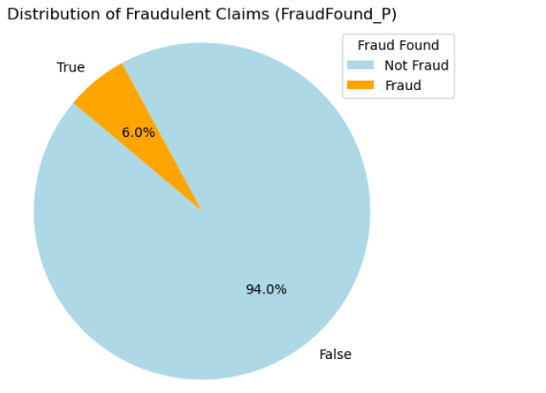
Exploratory Data Analysis
Insights: Visualizations and statistical analysis to understand data distributions and patterns.
Key Findings: High fraud rates in certain age groups, policy types, and vehicle categories.
Target Variable Distribution:
94% Not Fraudulent: The majority of the claims (94%) are identified as not fraudulent. Represented by the large blue section of the pie chart.
6% Fraudulent: A small portion of the claims (6%) are identified as fraudulent. Represented by the small orange section of the pie chart.
Significance:
Highlights the challenge in detecting fraud due to the rarity of fraudulent claims compared to non-fraudulent ones.
Emphasizes the importance of an effective fraud detection model to identify the small percentage of fraudulent claims.
Notes:
In our exploratory data analysis, we focused on understanding the distribution of fraudulent claims within our dataset.
The pie chart on this slide provides a clear visualization of this distribution. As we can see, only 6% of the claims are identified as fraudulent, while the remaining 94% are legitimate.
This significant imbalance underscores the challenge in accurately detecting fraud, as fraudulent claims are relatively rare.
It emphasizes the necessity of employing robust and precise models to ensure that we can effectively identify these fraudulent claims amidst a large volume of legitimate ones.
This insight guided our approach in selecting and tuning our models to enhance their performance in fraud detection.

Slide 6
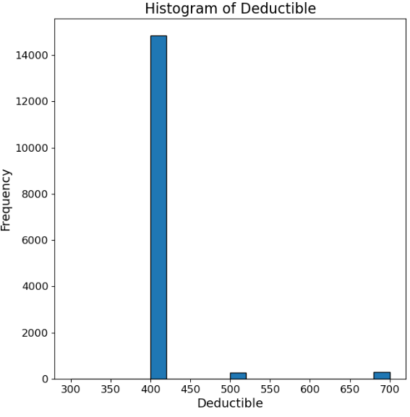
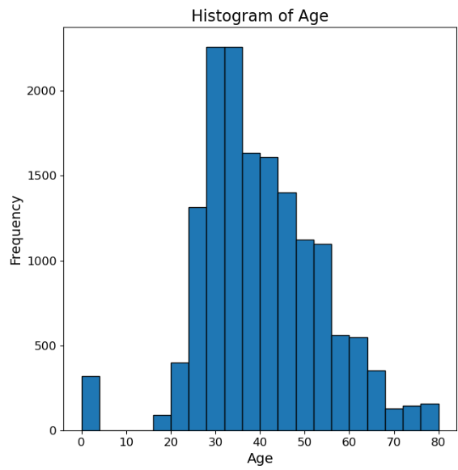
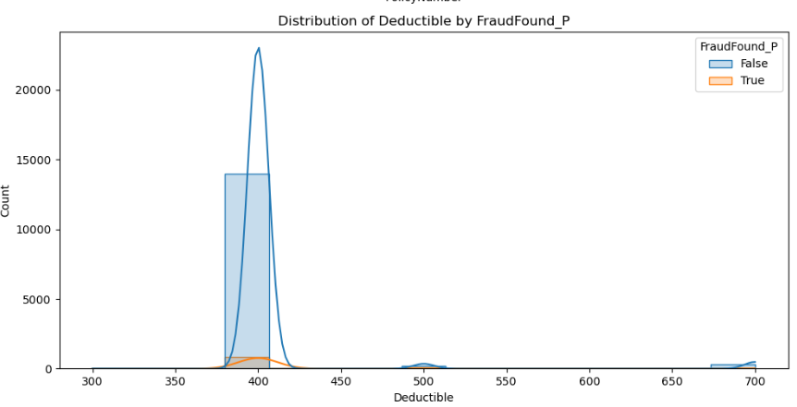
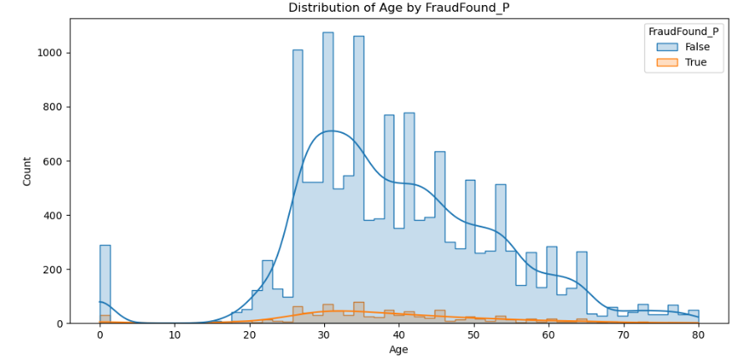
Exploratory Data Analysis
Numerical Feature Analysis
Histogram of Age
Histogram of Deductible
Age and Fraud Distribution:
Observation: Slight concentration of fraudulent claims in the 30-50 age range.
Deductible and Fraud Distribution:
Observation: No distinct deductible amount
that differentiates fraudulent claims, but
some extreme outliers below $350 and
above $600.
Notes:
In our data distribution analysis, we examined key variables such as Deductible and Age to understand their overall distributions and their relation to fraud detection.
Starting with the histogram of deductible amounts in the top left, we observe that most deductible values are concentrated around $500. The histogram of ages in the top right shows that the majority of claimants are in their 20s and 30s.
Moving to the bottom left, the distribution of deductible by fraud status indicates that both fraudulent and non-fraudulent claims have similar deductible amounts clustered around $500. This suggests that the deductible amount alone may not be a strong predictor of fraud.
On the bottom right, the age distribution by fraud status reveals a higher incidence of fraud among younger claimants, particularly those in their 20s and 30s. This insight suggests that age could be a more significant factor in predicting fraudulent claims.
These findings guided our model development process, helping us to focus on the most relevant features for fraud detection.

Slide 7

Feature Engineering
Vehicle Age
Age Group
Transform raw data into meaningful features
Apply domain knowledge to create new features
Handle missing values and outliers
Encode categorical variables
Scale numerical features
Balance classes with SMOTE
Deductible
Fault
Past Claims
Sex
Base Policy
Policy Type
Vehicle Category
Vehicle Price
Notes:
Feature engineering is a crucial step in our process, where we transform raw data into meaningful features that improve our model's accuracy. First, we applied domain knowledge to create new features that might be relevant for fraud detection, such as the age of the vehicle and the number of past claims.
Next, we handled any missing values and outliers to ensure our data's integrity. For example, we filled missing values using statistical methods and removed extreme outliers that could skew our model's performance.
We then encoded categorical variables into numerical formats using techniques like one-hot encoding, which allows our machine learning algorithms to process these variables effectively.
Additionally, we scaled numerical features to ensure they are on a similar scale, which is especially important for models sensitive to feature magnitudes, such as gradient boosting models.
To address class imbalance, where fraudulent claims are much rarer than non-fraudulent ones, we used SMOTE, a technique that oversamples the minority class, to create a more balanced dataset.
By carefully engineering these features, we lay a strong foundation for building robust and accurate models for fraud detection.

Slide 8
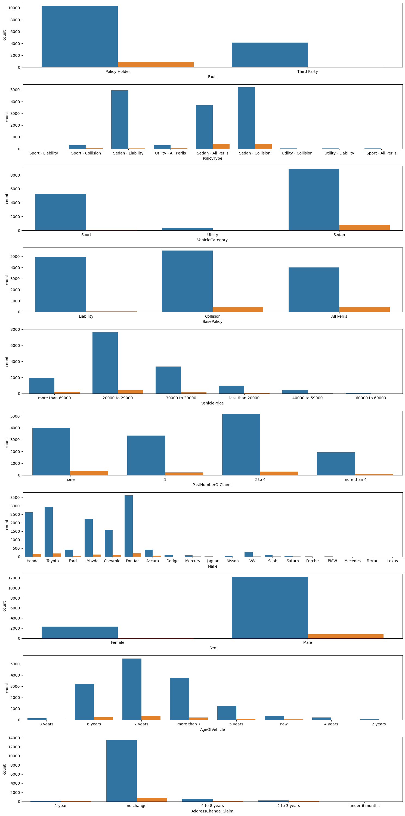
Feature Selection
Selected Features:
Age of vehicle
Age groups 18 - 50
Past number of claims
Vehicle price
Vehicle category
Base policy
Fault
Deductible
Policy type
Sex
Enhanced model performance by focusing on features with the highest predictive power.
Process:
Correlation Analysis: Used to find linear relationships between features and the target variable.
Chi-Square Test: Evaluated the association between categorical features and the target variable.
T-Test: Compared the means of numerical features between fraudulent and non-fraudulent claims.
Domain Knowledge: Incorporated insights from industry experts to identify important features.
Notes:
Let's discuss the feature selection process, which is a critical step in building an effective machine learning model.
Our objective was to identify the most relevant features that would improve the model's performance and interpretability.
We began by conducting a correlation analysis to find linear relationships between features and the target variable.
We also performed a Chi-Square Test to evaluate the association between categorical features and the target variable, and a T-Test to compare the means of numerical features between fraudulent and non-fraudulent claims.
In addition to these statistical methods, we incorporated domain knowledge from industry experts to identify important features.
This combined approach led us to select the following features: age of the vehicle, age groups between 18 and 50, the past number of claims, vehicle price, vehicle category, base policy, fault, deductible, policy type, and sex.
By focusing on these features, we enhanced our model's performance, ensuring it accurately identifies fraudulent claims while remaining interpretable.

Slide 9
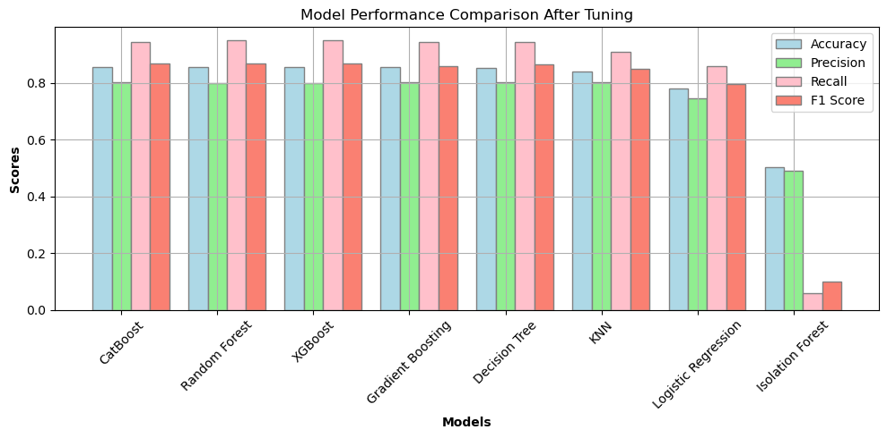
Model Development
Model Development:
Approaches Explored
Isolation Forest
Gradient Boosting Model
Decision Tree Classifier
XG Boost
Random Forest
K-Nearest Neighbor
Logistic Regression
CatBoost
Objective: To compare different models and select the best performing one based on accuracy and other metrics.
Notes:
With our data ready, we trained various machine learning models to detect fraudulent claims.
The models we trained included Isolation Forest, Gradient Boosting, Decision Tree, XGBoost, Random Forest, K-Nearest Neighbor, Logistic Regression, and CatBoost.
Each of these models brings a different approach to the table, helping us to understand the nuances of our dataset.
We evaluated these models using key metrics such as accuracy, precision, recall, and F1 score.
These metrics provided a comprehensive view of each model’s performance, allowing us to identify which model best balanced the need for identifying fraudulent claims without raising too many false alarms

Slide 10
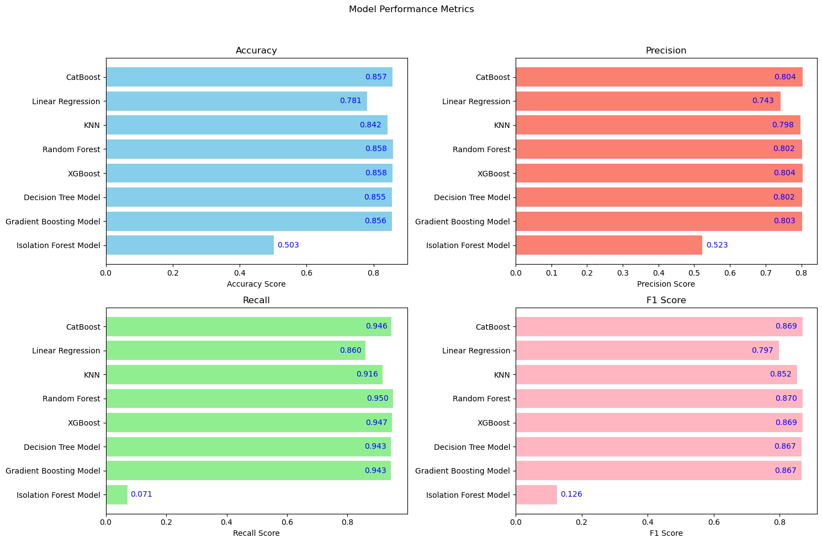
Model Evaluation
Model Evaluation:
Evaluation Metrics:
Accuracy
F1-score
Precision
Recall
The CatBoost model emerged as the top performer across all the key metrics.
It demonstrated significant improvement in fraud detection, making the most suitable model for deployment.
Significance of CatBoost Model:
Handling of Categorial Data
Robust Performance
Imbalance Handling
Notes:
After training our models, we compared their performance based on the evaluation metrics. The graph here provides a visual comparison of each model's accuracy, precision, recall, and F1 score.
Starting with accuracy, CatBoost achieved the highest score at 86%, closely followed by Random Forest and XGBoost. Precision, which measures the accuracy of positive predictions, showed similar results with CatBoost leading at 80%.
Recall, an indicator of how well the model identifies actual positives, saw CatBoost once again at the top with a remarkable score of 0.946. Finally, the F1 score, which balances precision and recall, highlighted CatBoost as the leader at 87%.
Isolation Forest, while useful for anomaly detection, showed significantly lower performance across all metrics. This indicates it's not suitable for our fraud detection needs.
Given these results, we selected CatBoost as our primary model for detecting vehicle insurance fraud due to its superior performance across all key metrics.

Slide 11

Conclusion
Summary of Findings
CatBoost emerged as the best model for detecting fraudulent vehicle insurance claims.
Other models like Random Forest and XGBoost also showed robust performance.
Isolation Forest was not suitable for this specific task.
Key Metrics
CatBoost achieved the highest accuracy, precision, recall, and F1 score.
Performance metrics for other models indicated they are also viable options.
Implications
Implementing these models can significantly reduce financial losses due to fraud.
Improved fraud detection leads to fairer premium pricing and better customer trust.
Notes:
In conclusion, our comprehensive analysis of multiple AI models for detecting fraudulent vehicle insurance claims highlighted the CatBoost model as the top performer across all key metrics, including accuracy, precision, recall, and F1 score.
This indicates its superior capability in accurately identifying fraudulent claims. Models like Random Forest and XGBoost also demonstrated strong performance, making them viable options.
However, the Isolation Forest model did not perform well and is not suitable for this specific task.
Implementing these models can help insurance companies reduce financial losses, streamline claims processing, and maintain fair premium pricing, ultimately fostering better customer trust.

Slide 12
Societal Impacts
Implementations and Recommendations
Deploy CatBoost Model
Primary model for fraud detection.
Supplementary use of Random Forest or XGBoost for robustness.
Continuous Monitoring and Retraining
Regular updates to adapt to evolving fraud patterns.
Ensure sustained model performance.
Integration with Claims Processing System
Seamless integration to automate fraud detection.
Enhances efficiency and accuracy in processing claims.
Financial Protection
Reduced financial losses for insurance companies.
Lower premiums for customers due to reduced fraud.
Customer Trust
Fair and transparent claim processing.
Enhanced customer satisfaction and loyalty.
Industry Standards
Setting a benchmark for fraud detection in the insurance industry.
Encouraging other companies to adopt similar technologies.
Notes:
Recommendations:
We recommend deploying the CatBoost model as the primary tool for detecting fraudulent vehicle insurance claims due to its superior performance. To ensure robustness, Random Forest or XGBoost can be used as supplementary models.
Continuous monitoring and periodic retraining of these models are essential to adapt to evolving fraud patterns and maintain their effectiveness.
Additionally, integrating these models with the claims processing system will automate fraud detection, enhancing both efficiency and accuracy in handling claims.
Societal Impacts:
Implementing advanced AI models for fraud detection has significant societal impacts.
Firstly, it provides financial protection by reducing losses for insurance companies, which can result in lower premiums for customers. This enhances the affordability of insurance.
Secondly, the fair and transparent processing of claims builds customer trust, leading to higher satisfaction and loyalty.
Lastly, by setting a benchmark for fraud detection, we can encourage other companies within the industry to adopt similar technologies, driving overall improvements in the insurance sector's standards and practices.

